Slide 1
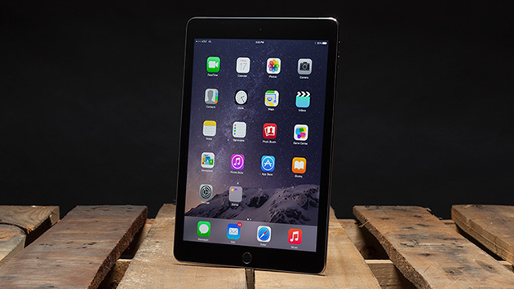
Mobile Device Update Fall 2017
Markus Yager, CMA
MAAO GIS Committee
City of Maple Grove

Slide 2
Why Mobile Devices?
Counties and cities are continuing to implement mobile devices for GIS and data collection
Technology can promote work effectiveness, productivity, accuracy, and cost savings
Avoid double data collection
“Paperless” office/field work
Data accessible in the field
Integrate CAMA data with mapping
Visual
Equalization
New Ways of Doing Things
Notes:
Counties and cities are continuing to implement mobile devices for GIS and data collection
- in the past few years we have seen interest grow tremendously
Technology can promote work effectiveness, productivity, accuracy, and cost savings
Avoid double data collection – enter data in the field can be huge time savings
“Paperless” office/field work – everyone its trying to go that way, not only for the perceived cost savings but the perceived ease of data access, all searchable from your desk or in the field
Data accessible in the field – with the possibility of mobile devices comes the desire to have more info in the field
Integrate CAMA data with mapping
Visual – showing data visually/spatially on a map can help show trends that are hard to show with numbers
Equalization – Seeing equalization data on a map can help quickly spot equalization problems
New Ways of Doing Things
- As technology advances we can review old processes and perhaps make them more efficient
- Technology enables uses never though possible – or just wouldn’t have ever thought of

Slide 3
Types of Mobile Devices
There are numerous types of mobile devices:
Android Tablets
Google’s Android operating system
Wide variety of sizes (7-13 inches)
Windows Tablets
Microsoft’s Windows 10 operating system
Wide variety of sizes (7-13 inches)
iPads
Apple’s iOS operating system
Multiple sizes (7.9, 9.7, 10.5, 12.9 inch)
There is no “one size fits all” device
Constantly changing world
Notes:
There are numerous types of mobile devices:
Android Tablets – most common and widest variety, range from very cheap to very expensive
Google’s Android operating system – built to be adaptable to wide variety of devices, with that comes a lack of polish, app store is not as developed
Wide variety of sizes (7-13 inches)
Windows Tablets – rough start
Released last year: Microsoft’s Windows 10 operating system –basically converts from desktop to tablet automatically depending on how you are using the device.
Wide variety of sizes (7-13 inches)
iPads
Apple’s iOS operating system -
Now in 4 sizes (7.9, 9.7, 10.5 12.9 inch) – iPad mini (4), iPad, & iPad Pros
There is no “one size fits all” device – different devices work better for different people/needs; purpose is not to convince you that a certain way is the best way but just to get you thinking about the potential benefits and challenges different mobile devices
Constantly changing world – Windows 10 is now a few years old and on over 300 million devices, new iPads just announced, new Android tablets almost daily
Apple sells more devices (iPhones, iPads, etc) than Windows sells – crazy just a few years ago!

Slide 4
2017 Mobile Device Survey Results
Great Response
Updated Data from 71 Cities/Counties (94 Total)
Strong Interest in this Data
Data that continues to change
62% of respondents were either testing or using mobile devices in the field
This is a SIGNIFICANT increase (around 10%)
Several respondents noted that they were still waiting on CAMA software upgrades to proceed

Slide 5
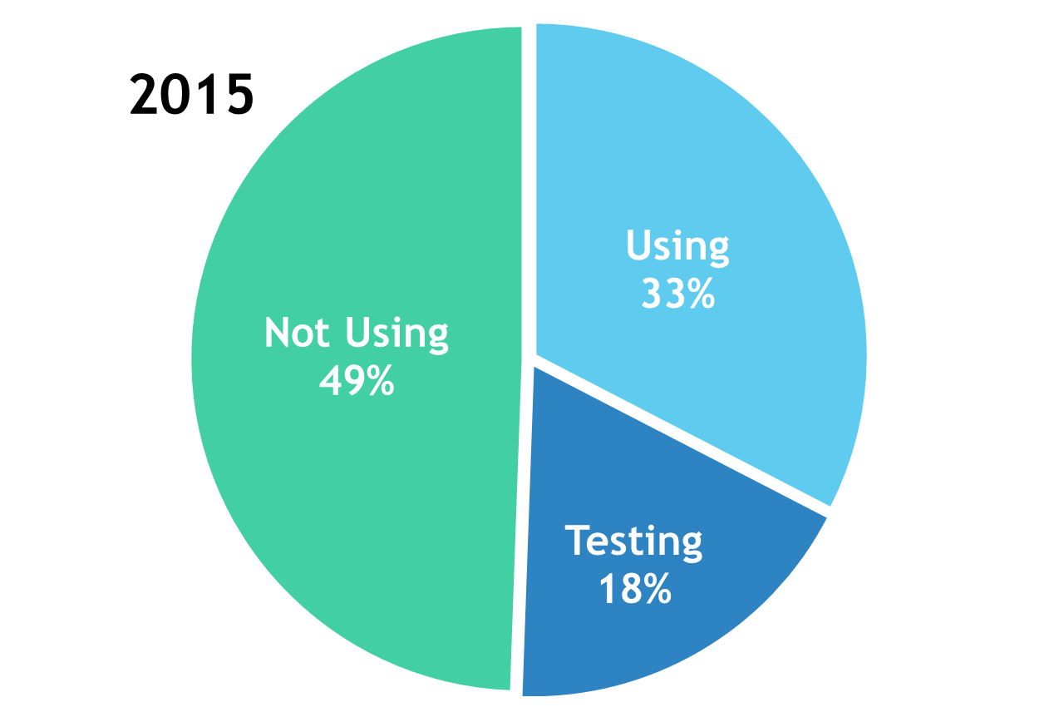
How Many are Using Mobile Devices?

Slide 6
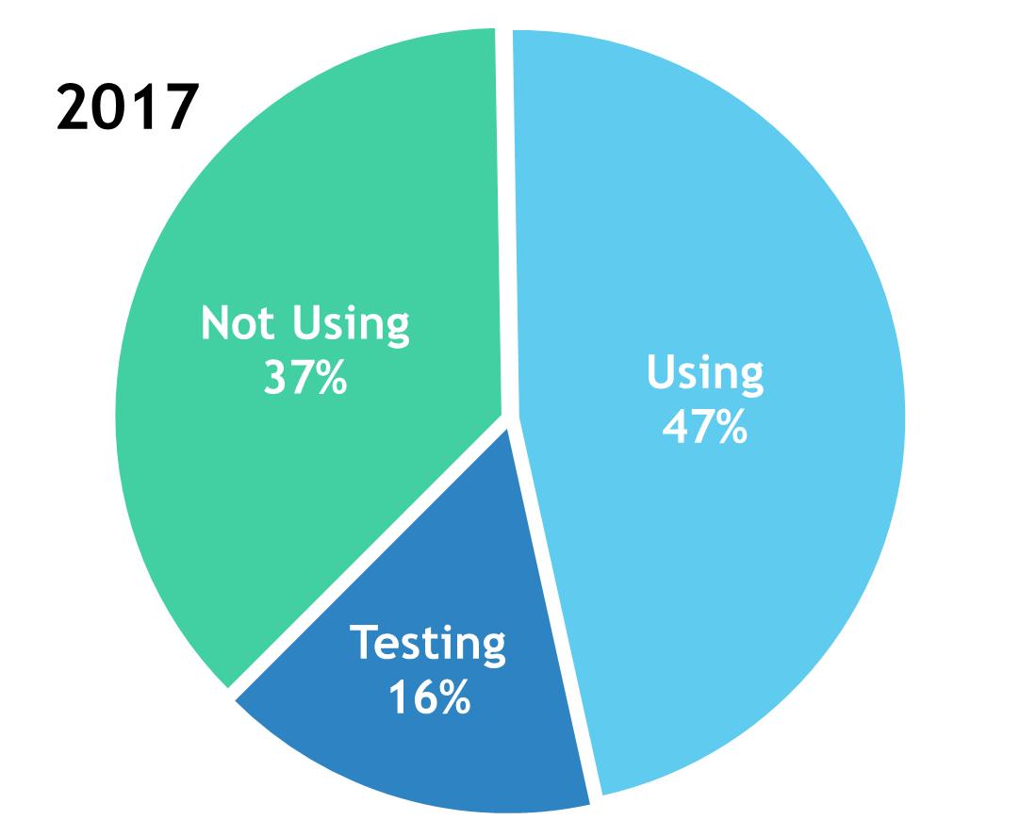
How Many are Using Mobile Devices?
Notes:
Notice the jump in using! This is significant!

Slide 7
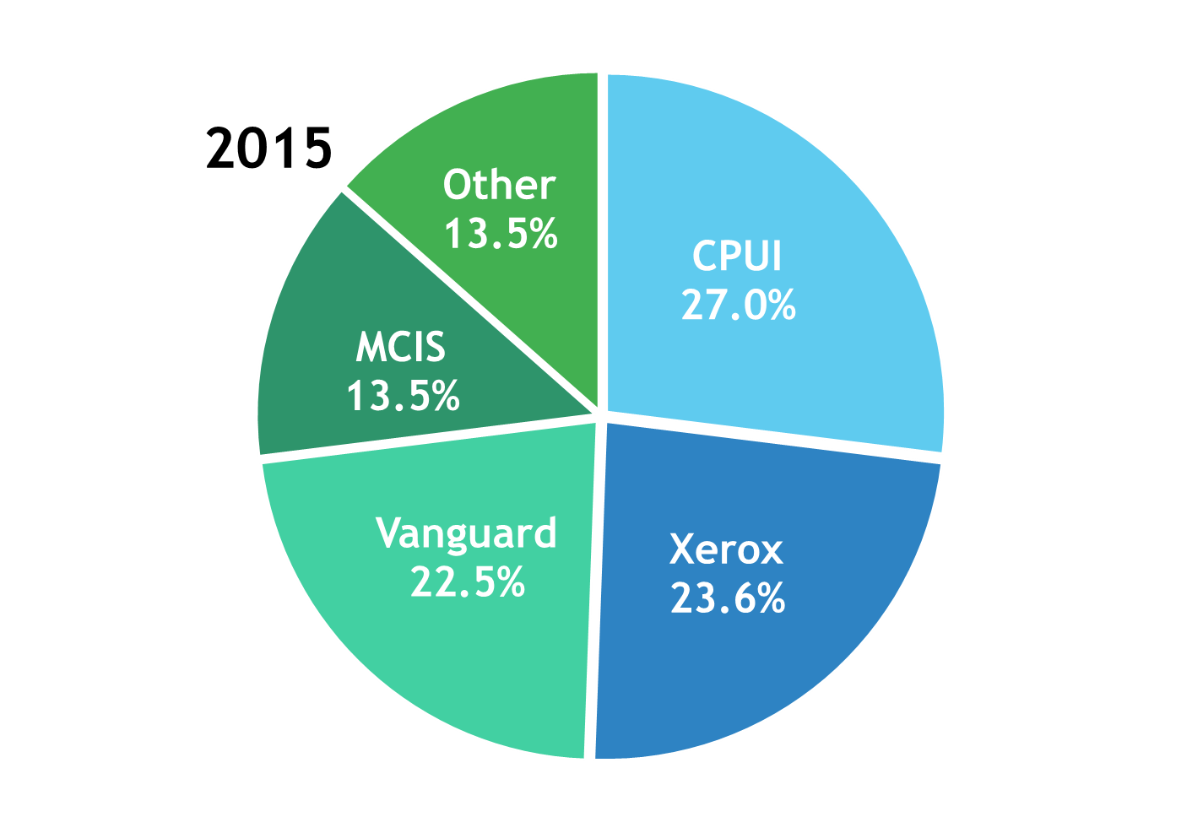
What CAMA Vendors Are in Use?
Notes:
Split between 4 major vendors and several smaller vendors

Slide 8
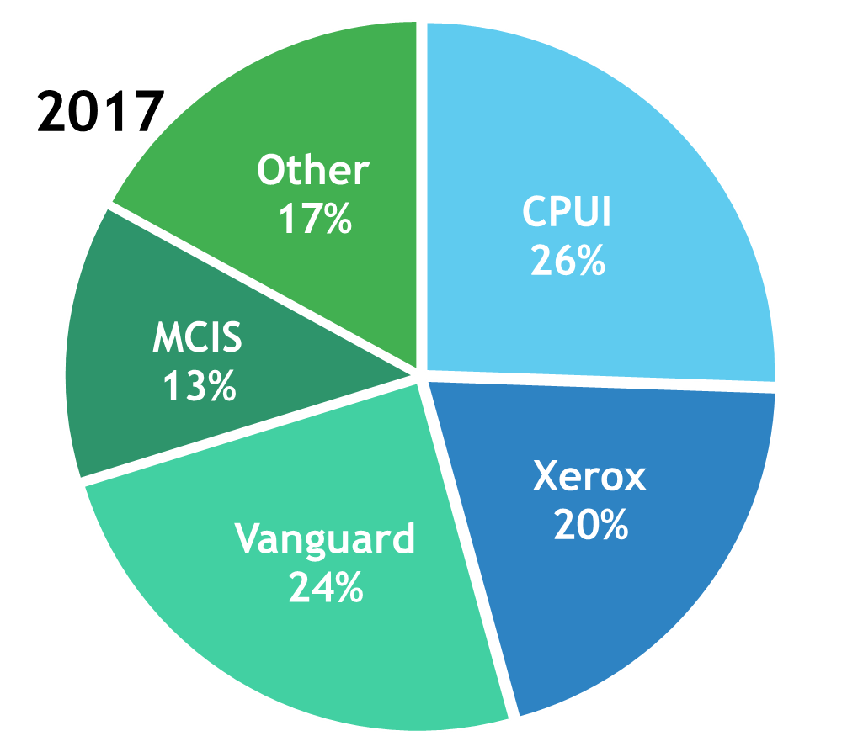
What CAMA Vendors Are in Use?
Notes:
Overall, the breakdown is similar, seeing a slight drop in the Xerox percentage and an increase of jurisdictions switching to Vanguard.

Slide 9
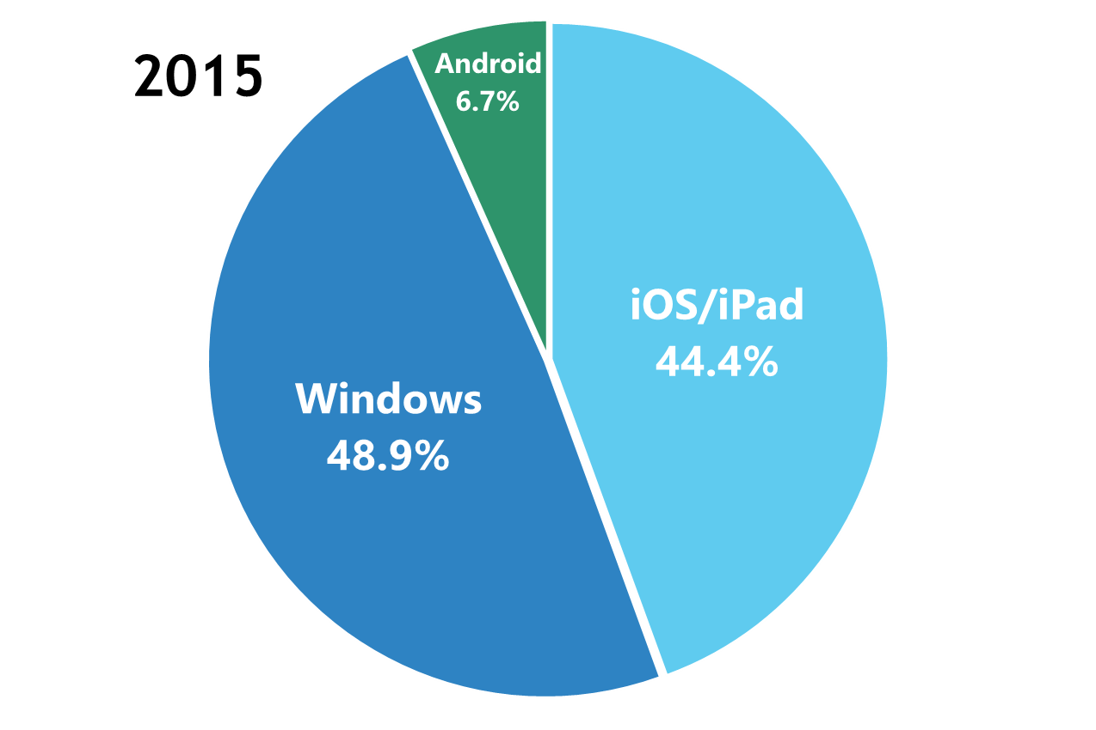
Operating System Breakdown

Slide 10
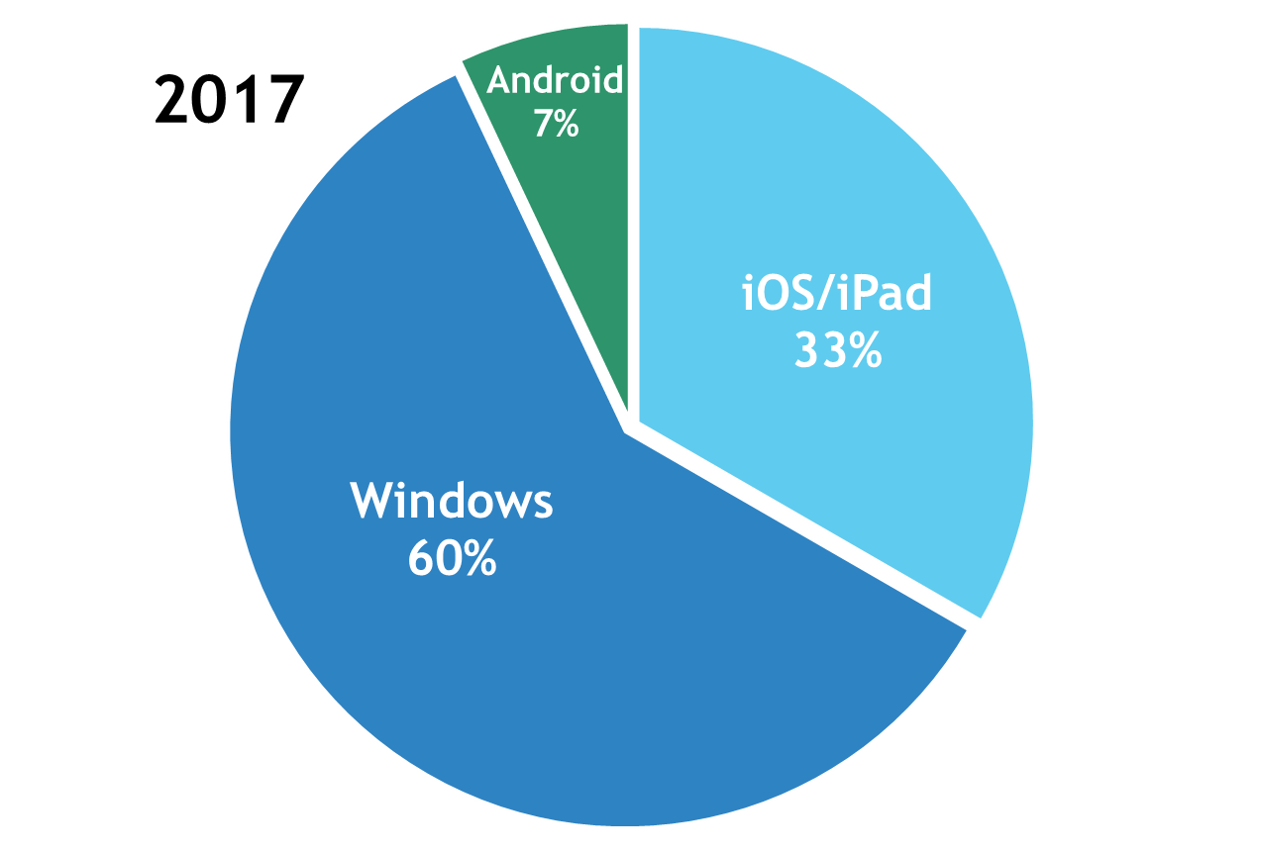
Operating System Breakdown
Notes:
Looking at the percentages, it looks like iPads are becoming less popular – but this is not quite the case
The number of iPads in use actually went up – we just heard back from more of those who didn’t previously respond and were using windows.
Vanguard’s CAMA Vision has also seen an uptick in usage, and this is Windows-based
Operating System – Microsoft Windows (variety of devices) versus Apple’s iOS (on iPads)
It’s amazing the amount of iPads being used
Consumers like them and understand them and that is leading to success in government/enterprise
Apple is beginning to make a push into the enterprise market with a partnership with IBM
The old line that iPads are consumption devices is less and less true
5 years ago I would have never thought the iPad would be as successful in business/government
Constantly changing world – what will the next 5 years bring?

Slide 11
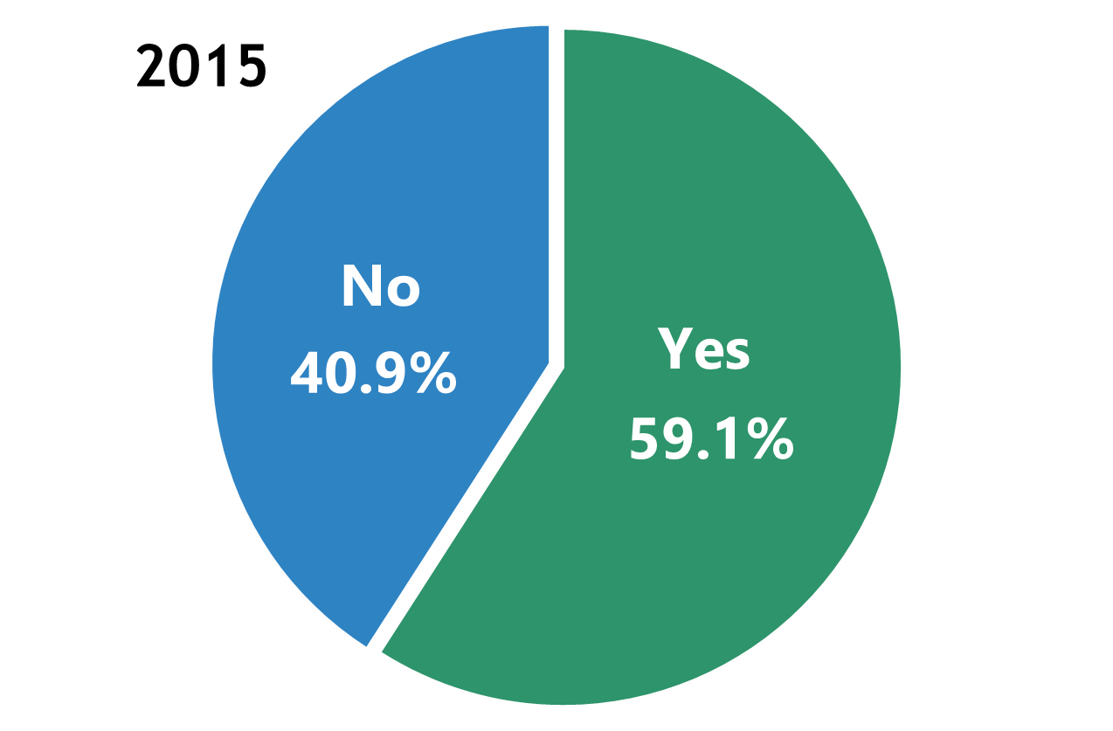
Question: Direct Input into CAMA?
Notes:
In general, a “NO” means writing on a digital “PDF” field card and entering the data back at the office. Some also just use a note-taking app on the tablet and record any changes back at the office.
Suprising that 40% do not have direct CAMA input – seeing some benefit from
Some are okay with this but most see it as a stepping stone to direct data entry or a checkout system

Slide 12
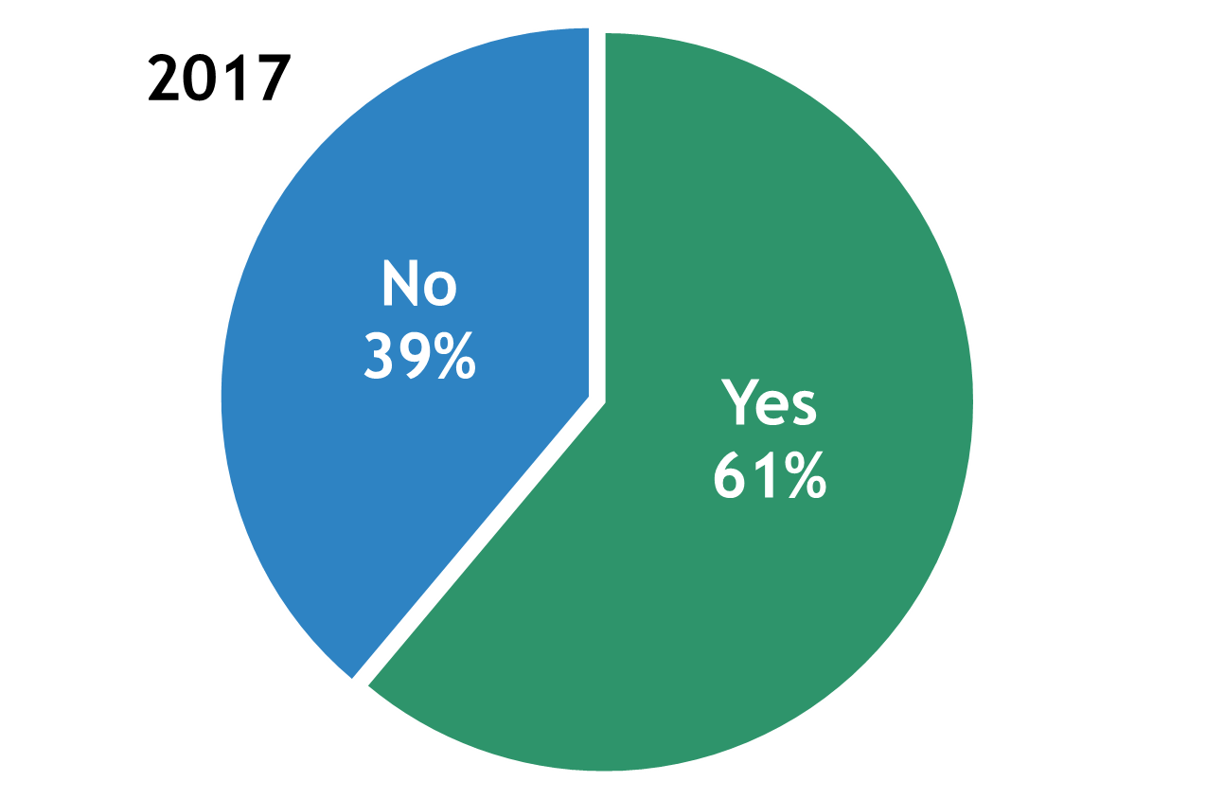
Question: Direct Input into CAMA?
Notes:
2017 VS 2015 – Data basically unchanged
In general, a “NO” means writing on a digital “PDF” field card and entering the data back at the office. Some also just use a note-taking app on the tablet and record any changes back at the office.
Suprising that 40% do not have direct CAMA input – seeing some benefit from
Some are okay with this but most see it as a stepping stone to direct data entry or a checkout system

Slide 13
Questions?

Slide 14
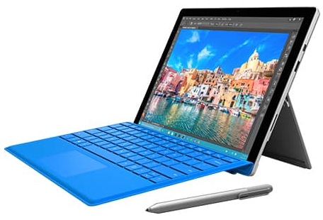
Windows: Microsoft Surface Pro ($799+)
12 inches/1.7 lbs.
~8 hour battery life
Pros:
Desktop-class performance
Works w/Windows Software
USB ports
Pen included
Keyboard available
Cons:
Not available w/mobile data
Tablet app store still limited
Heavier and more expensive

Slide 15
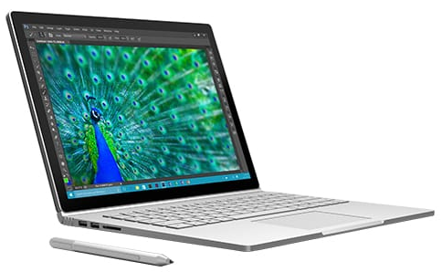
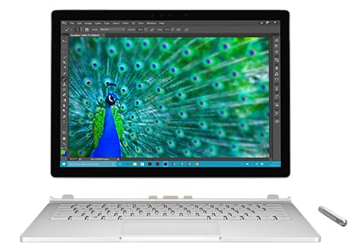
Windows: Microsoft Surface Book ($1499+)
Pros:
Detachable screen
High quality laptop experience
Performance
Keyboard
~10 hour battery life (as laptop)
Works w/all Windows Software
Pen included
Cons:
Tablet app store limited
Tablet battery life only 3-4 hrs
No mobile data
EXPENSIVE!

Slide 16
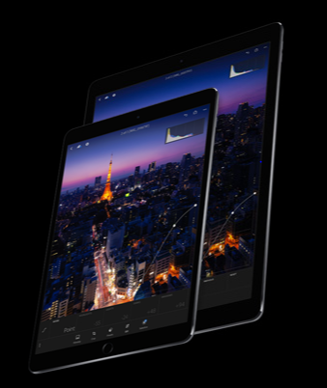
iOS: Apple iPad Pro 10.5” ($649+) 12.9” ($799+)
Pros:
10.5 in/1 lb or 12.9/1.6 lbs
~9-10 hour battery life
Available with mobile data
Best tablet app selection
Most “mature” tablet
Great Camera
Infinite Accessories
Cons:
Compatibility (depending on CAMA/software vendor)

Slide 17
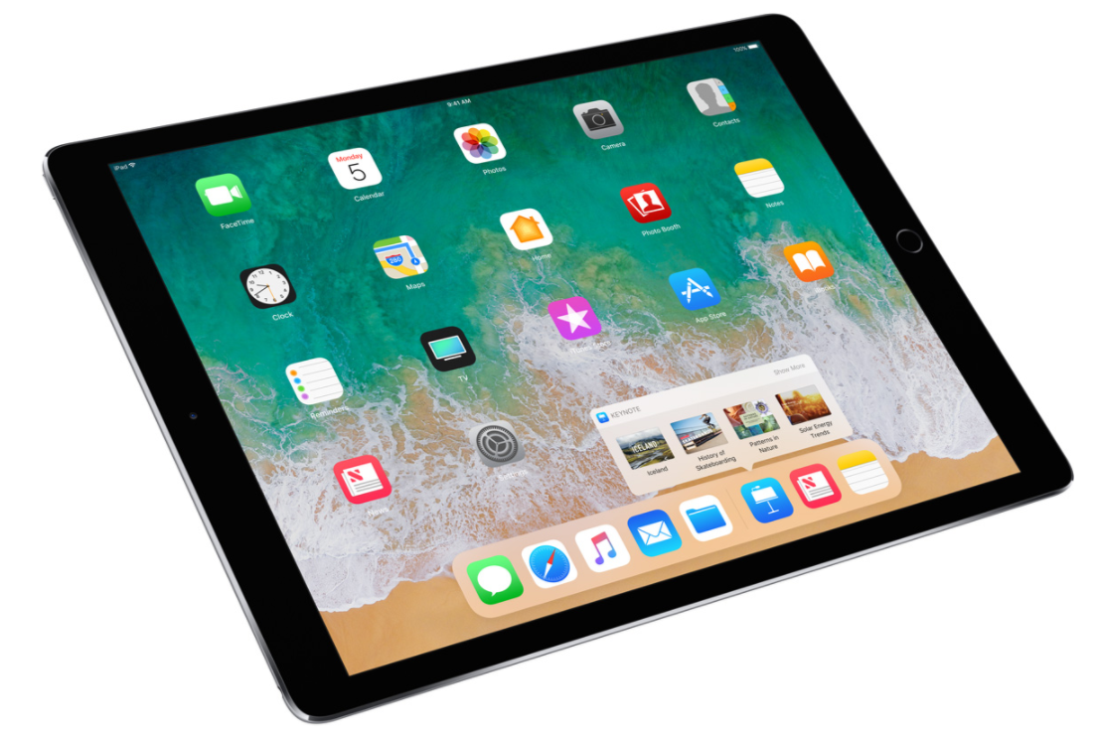
New iOS 11 Features
Split View/Multitasking, Drag & Drop
Apple Pencil (iPad Pros Only)
Reduced Glare (Easier to view in sunlight)
Thinner/Lighter than ever
More capable apps
Notes:
Split View/Slide Over – Multitasking
Not limited to just one app on the screen
Can do “work” side by side
Drag and Drop items between two open apps
Apple Pencil (iPad Pros Only)
One of the most accurate, true to life digital writing tools
Reduced Glare (Easier to view in sunlight)
With the 10.5 iPad Pro , the sunlight readability problem is essentially gone
Thinner/Lighter than ever
At 1 lb for the 10.5 inch iPad Pro, it is amazing how much computer is crammed in such a small device
More capable apps
Tablet apps are getting better and better – I much prefer to edit PDFs on my iPad than using Adobe on the desktop

Slide 18
Bottom Line:
Don’t Give up!
Variety in Quality
Size/weight
Battery life
Durability
Reparability
Connectivity
Accessories
Cost of entry
Screen readability
Camera Quality
Variety in Expectations
Data Collection
Direct Data Input
GIS/Mapping
Compatibility
Photos
Notes:
Variety in Quality
Size/weight -
Battery life – need all day or the ability to quickly charge
Durability – needs to be rugged enough to take out in the field – if it breaks your stuck
Reparability – can it be quickly repaired or replaced to minimize or eliminate down time?
Connectivity – varying needs here. Metro – always-on connection might work, outstate not so much
- How does the sync work? How do you ensure data does not get lost?
Accessories – not much good without a case, car charger, etc. Cost of entry – range from a couple hundred to several thousand dollars – barrier to small cities/counties with tight budgets
Screen readability – can you read it in the sunlight? Is it bright? Is it anti-glare? How is the screen quality?
Camera Quality – can this replace a digital camera in the field, making a true all-in-one device?
Variety of Expectations
Data Collection – mere data collection, replace paper and not much more
Direct Data Input - save time not only in printing and organizing field cards but in data entry
GIS/Mapping – how does mapping work with the mobile device? Is it integrated or a separate application? Is it based on mapping?
Permits – Ability to locate and view building permits with the device
Compatibility – Will your Windows software work with an Apple or Google product? What software is needed on the device?
Photos – can we easily take photos with the device and tie them instantly to the parcel?

